Slide 1

Dependency Injection
or
Inversion of Control

Slide 2

Martin Fowler
Author

Slide 3


Slide 4

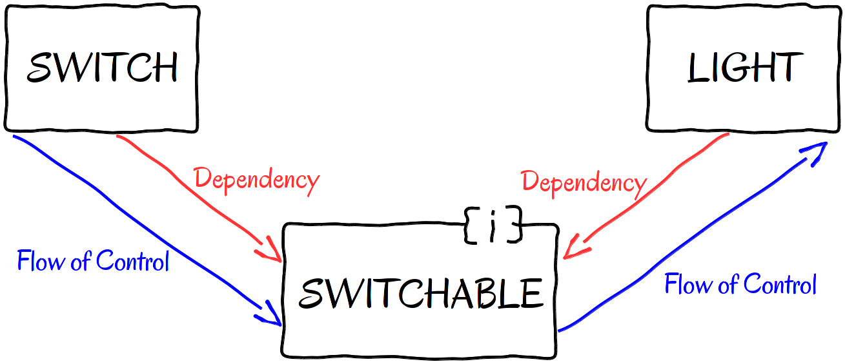
Прямая зависимость(Высокая связность)
Инверсия зависимости(Низкая связность)

Slide 5
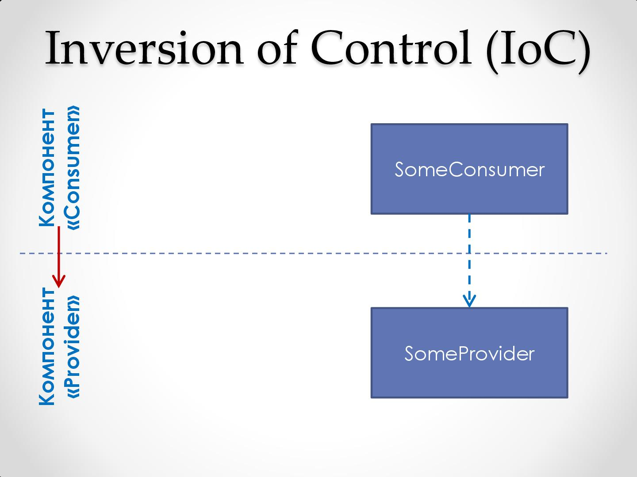

Slide 6
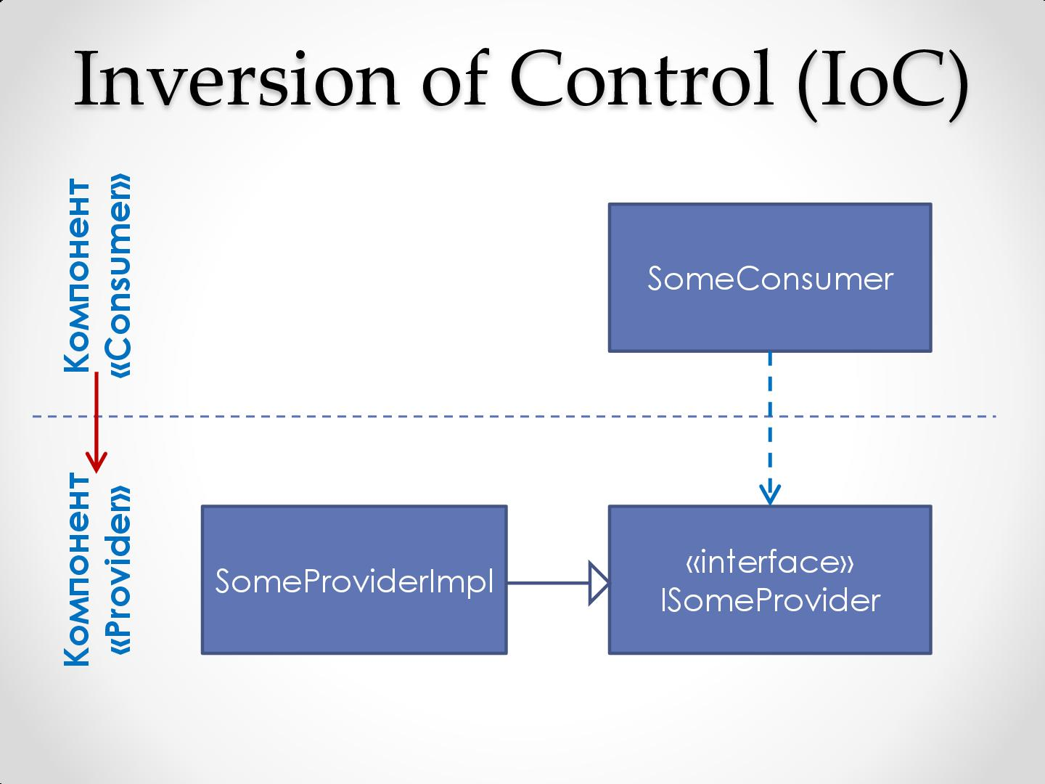

Slide 7
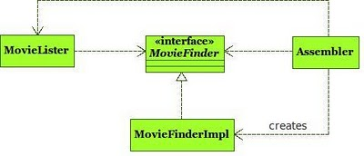

Slide 8
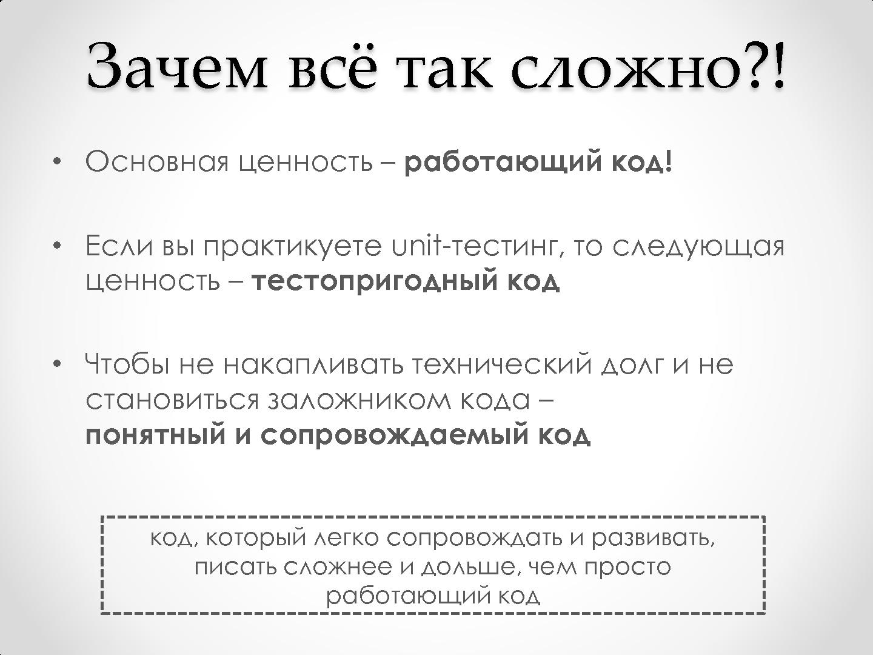

Slide 9
А если не писать понятный и сопровождаемый код?

Slide 10
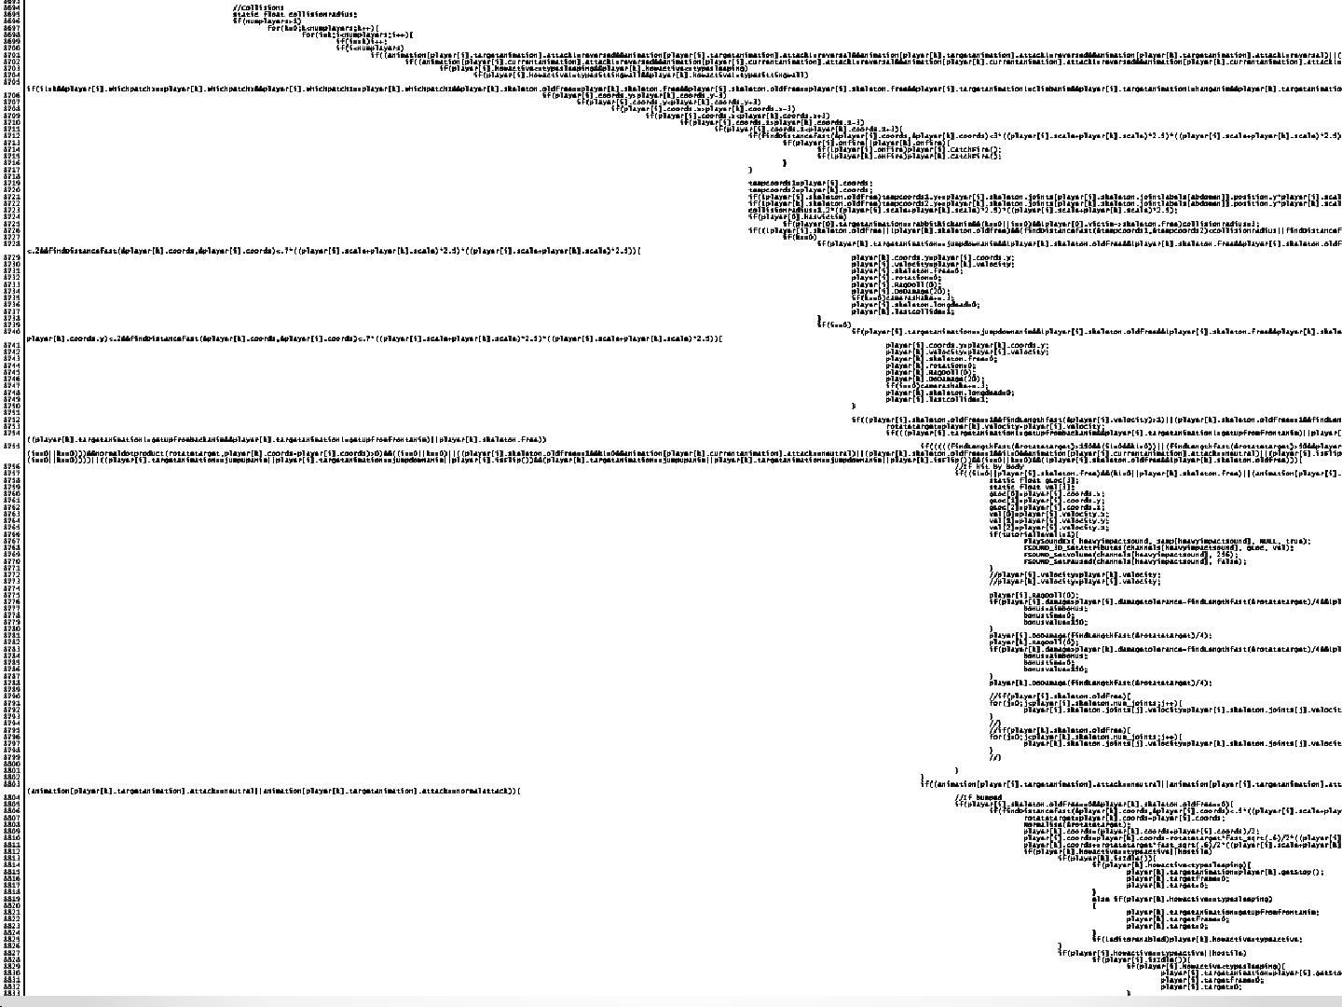

Slide 11
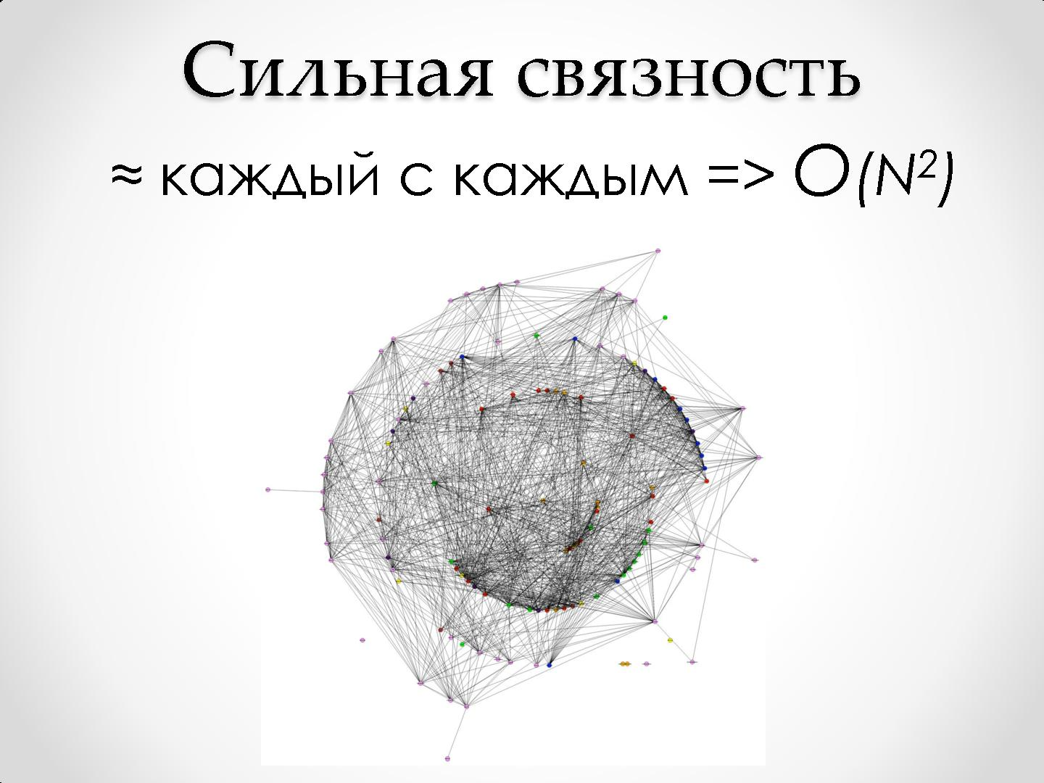

Slide 12


Slide 13
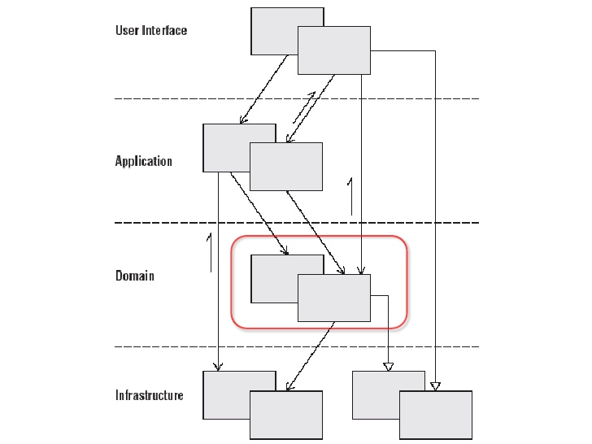

Slide 14
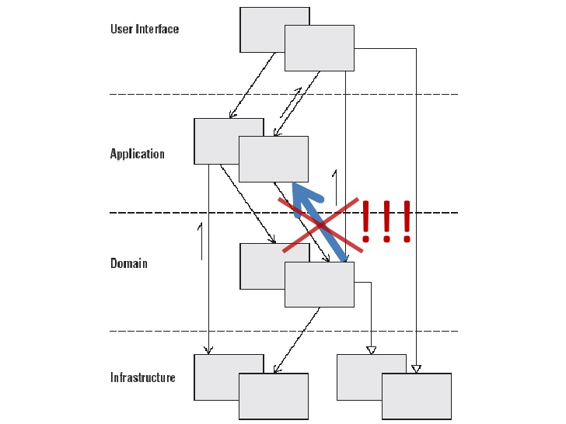

Slide 15
Frameworks

Slide 16

Oxen iPhone Commons
Code license
Apache License 2.0

Slide 17
How to create container?

Slide 18
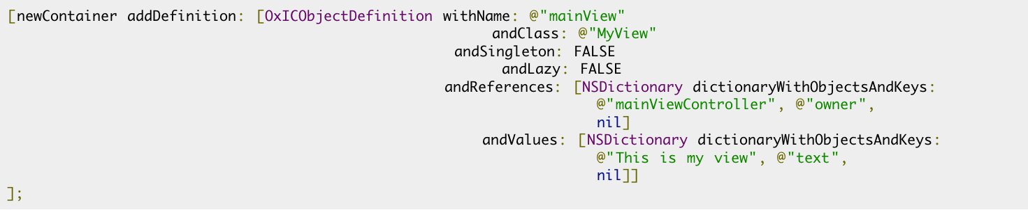
How to manage dependency in the code?

Slide 19
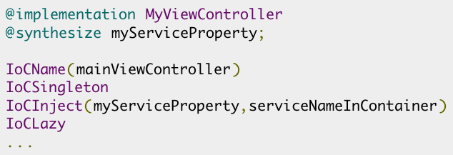
How to manage dependency in the annotation style?

Slide 20
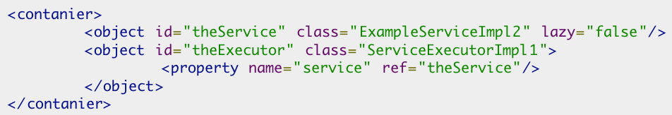
How to manage dependency in the xml?

Slide 21
How to get the object from container?

Slide 22
Advantages
* The container holds definitions about objects. No object is created until somebody request it.
* The definition can indicate that the object must be lazy. That is, when the object is requested, a proxy to such object is returned.
* Container instantiation can be done by code and "annotations" (like Guice/Spring) or by XML (like Spring).

Slide 23
Disadvantages
* There is no direct support for ARC(Automatic Reference Counting). To resolve this issue – include the framework as binary library.
* Be careful! Object reference is a string identifier. Similar to key-value coding. It's not save. To avoid broken reference issues use some smart refactoring instrument(AppCode for example).

Slide 24
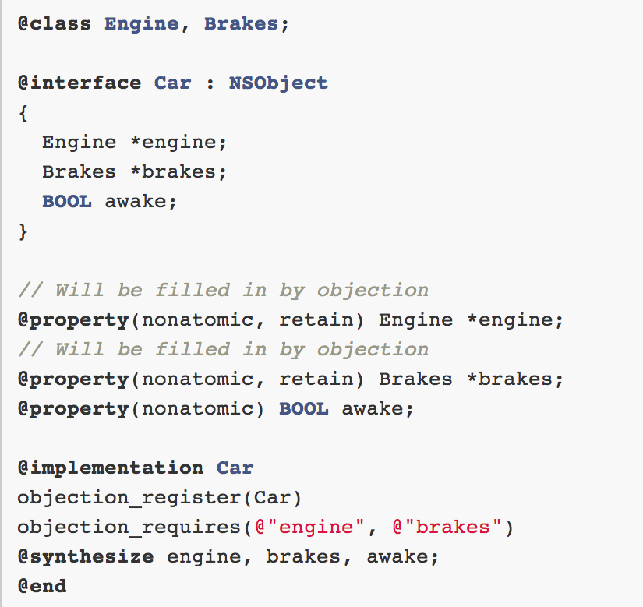
Example

Slide 25
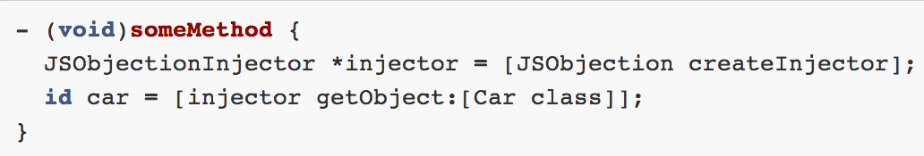
Fetching Objects from Objection

Slide 26
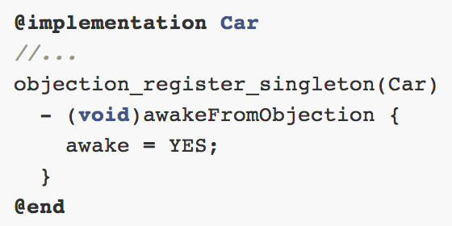
Awaking from Objection

Slide 27
Advantages
* The syntax is really compact. Does not reduce the readability.
* More type safe since uses class as a key instead of string identifier (getObject:[Request class]).

Slide 28
Disadvantages
* There is no direct support for ARC(Automatic Reference Counting). To resolve this issue – include the framework as binary library.
* All dependencies should be set in the code. There is no other way to manage.

Slide 29
Спасибо!!!
Вопросы?

